Slide 1
创建一个Github仓库(1)
2025.10.23

Slide 2
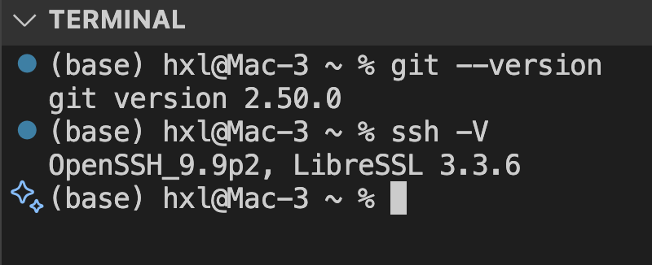
检查是否安装了ssh和git
ssh -V
git --version

Slide 3
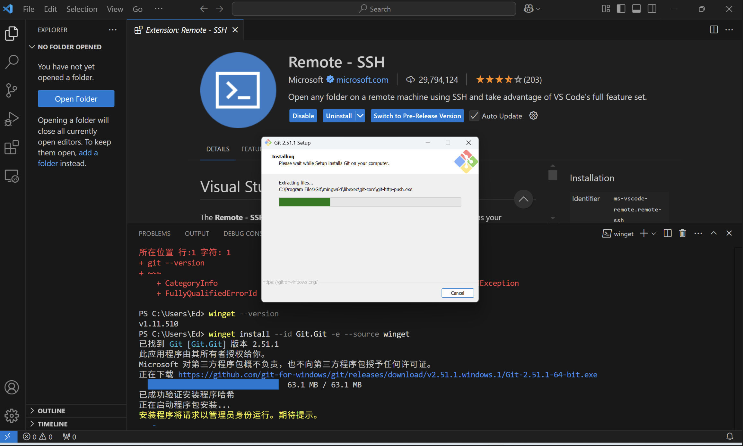
Windows powershell安装git

Slide 4
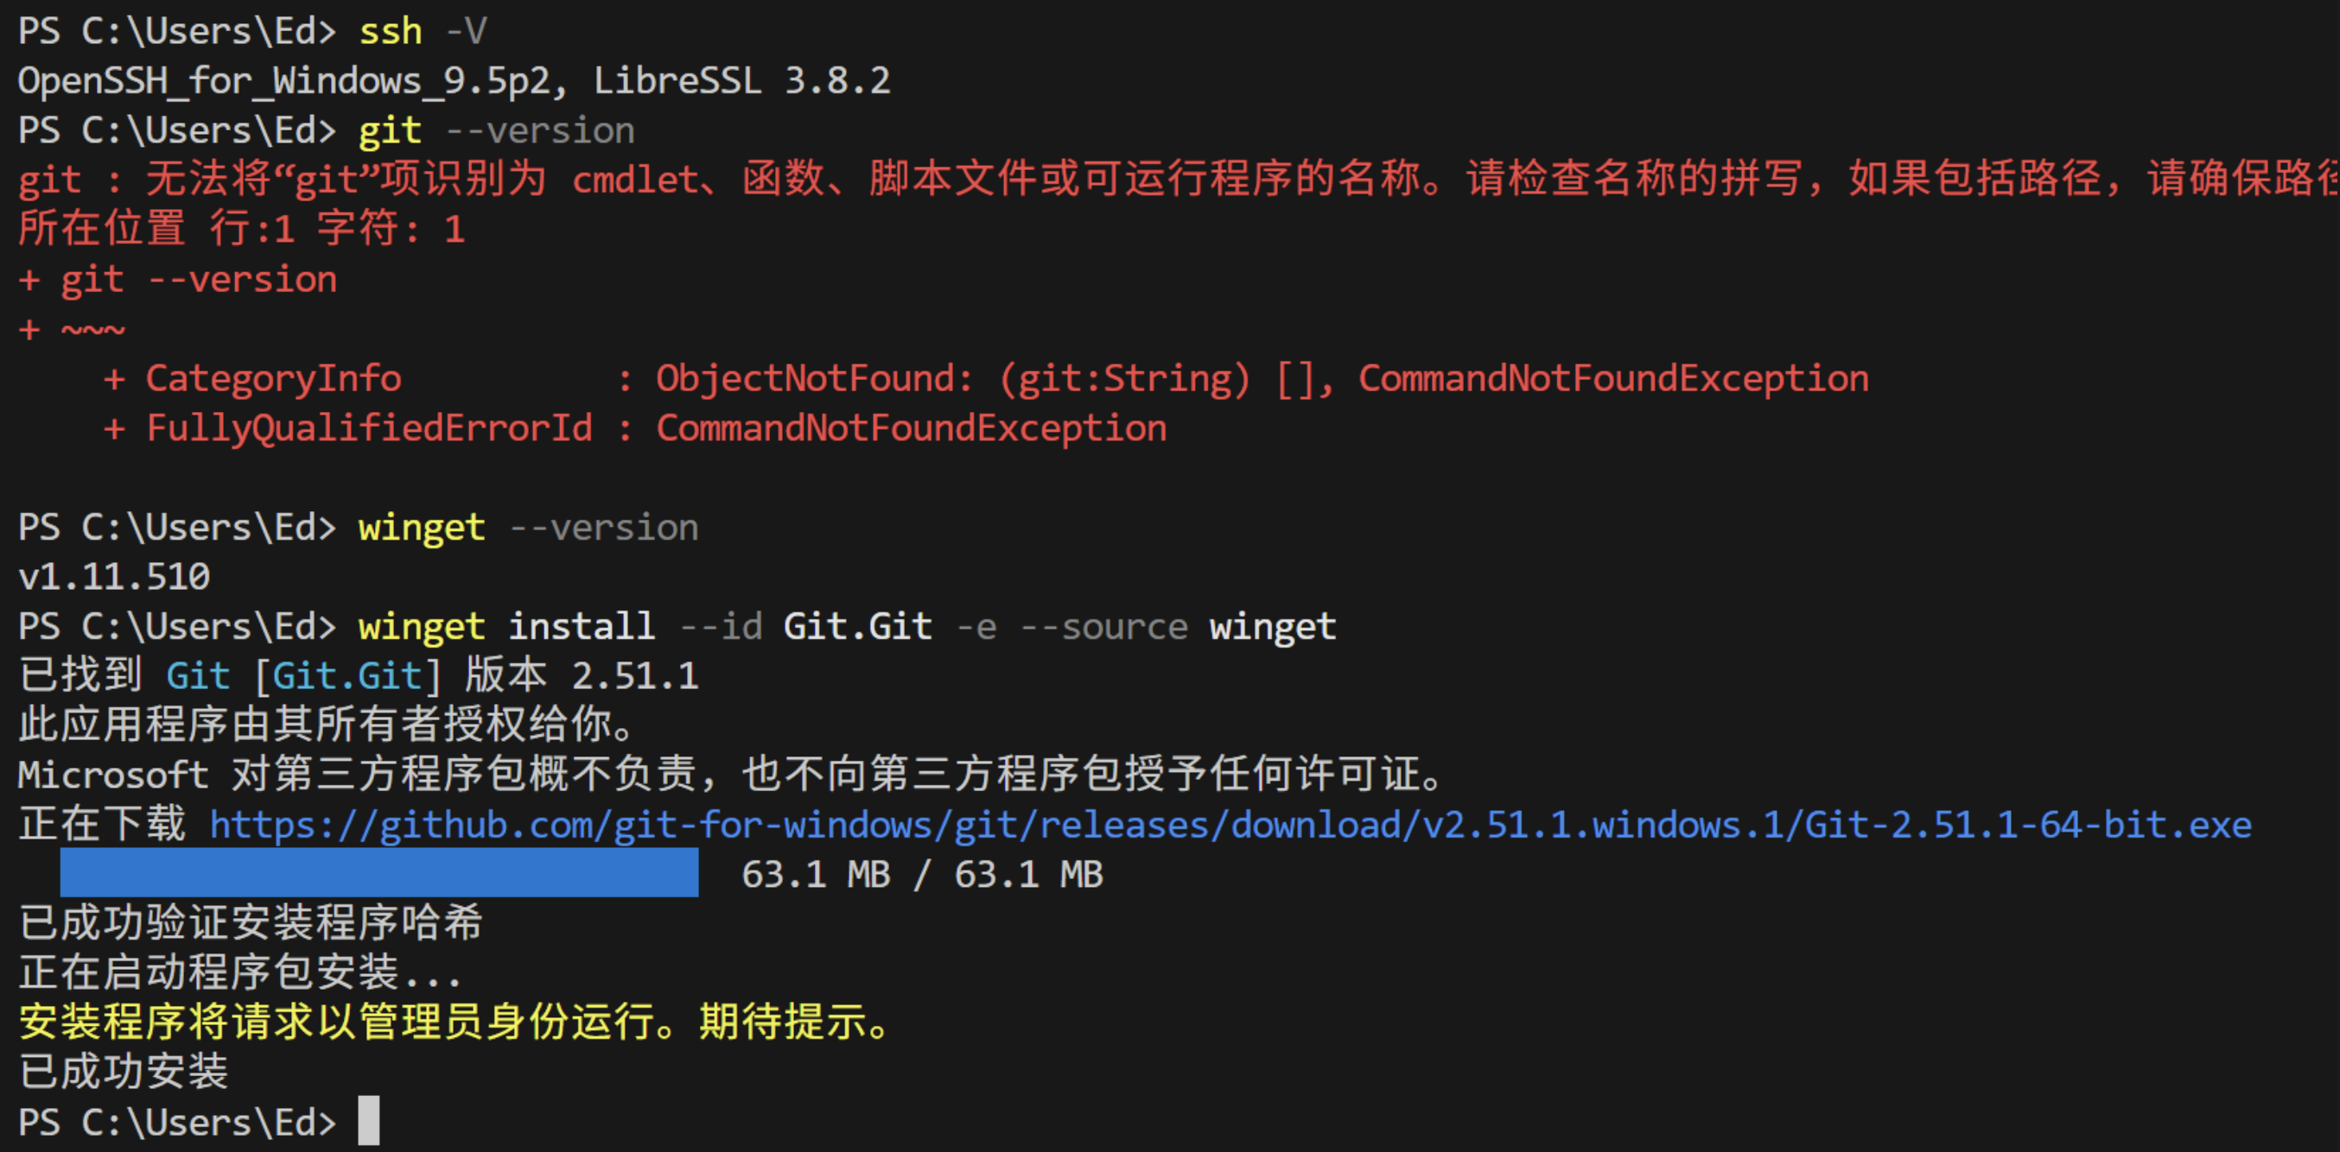
winget install --id Git.Git -e --source winget

Slide 5
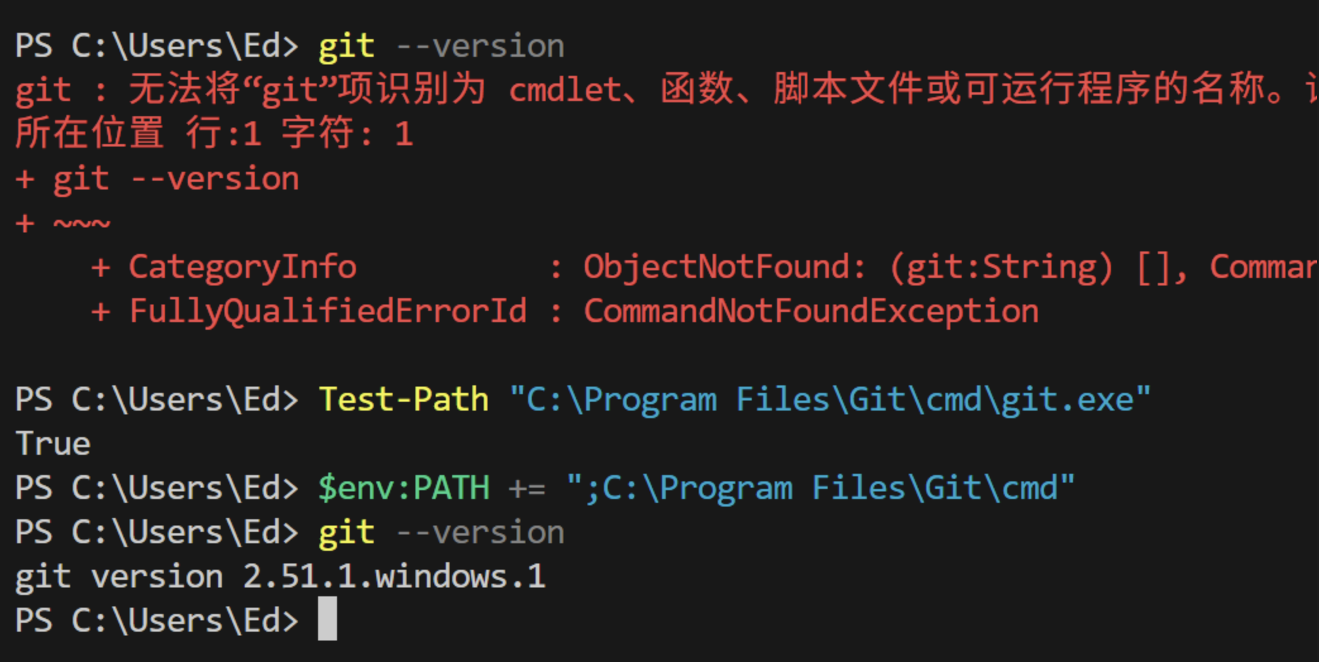
Test-Path “C:\Program Files\Git\cmd\git.exe”
$env:PATH += ";C:\Program Files\Git\cmd"

Slide 6
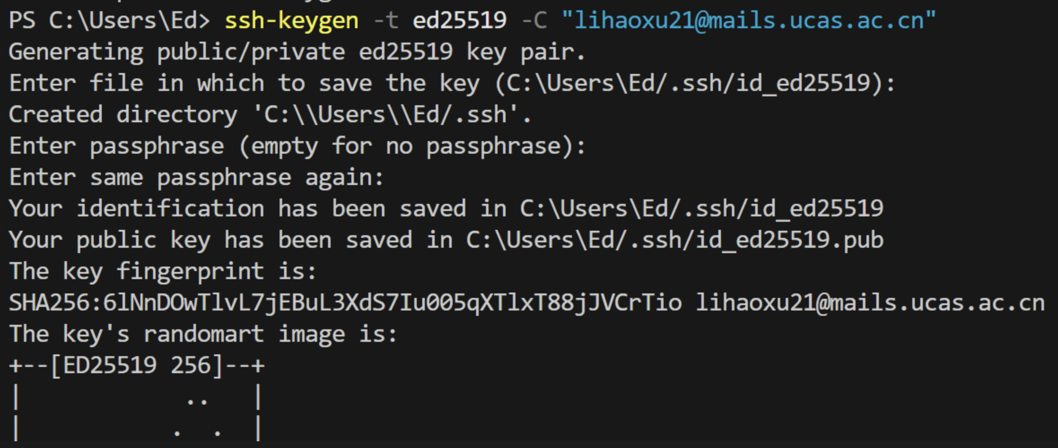
ssh-keygen -t ed25519 -C “lihaoxu21@mails.ucas.ac.cn”

Slide 7
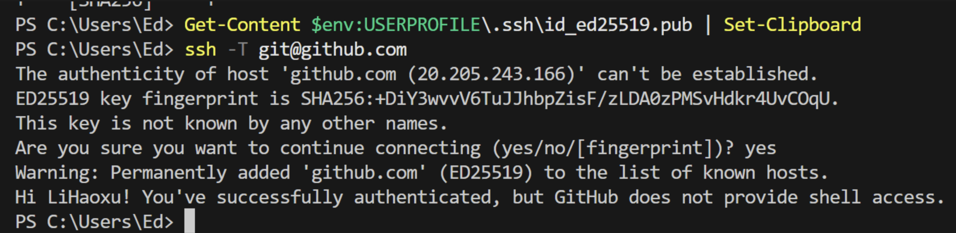
Get-Content $env:USERPROFILE\.ssh\id_ed25519.pub | Set-Clipboard
ssh -T git@github.com

Slide 8
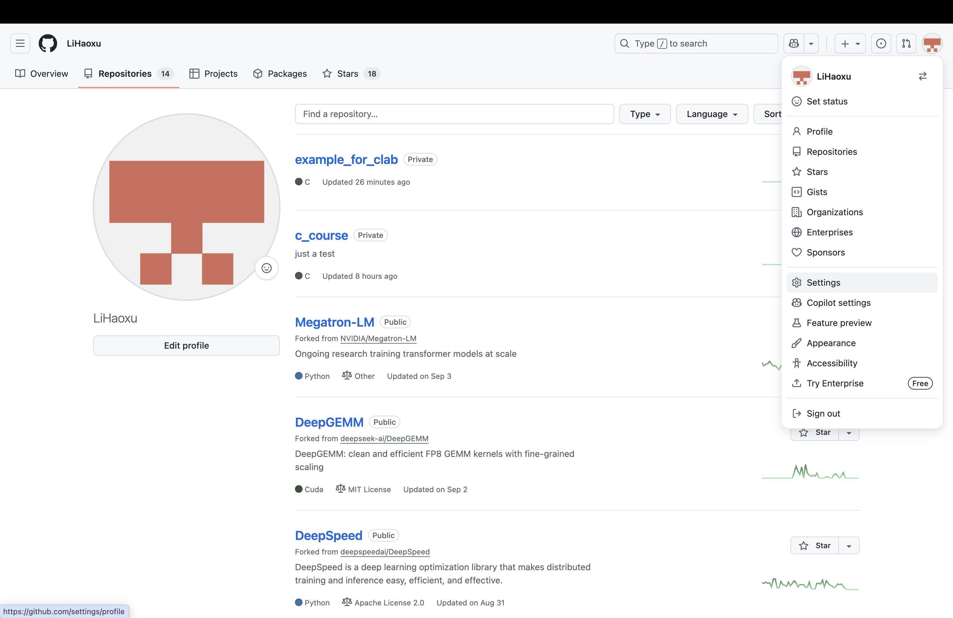

Slide 9
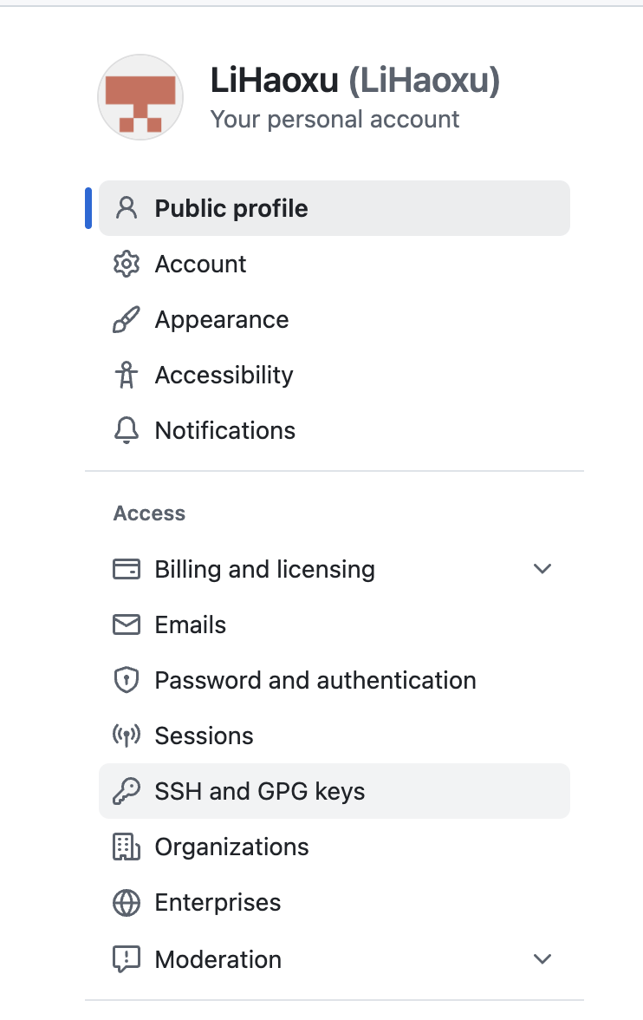
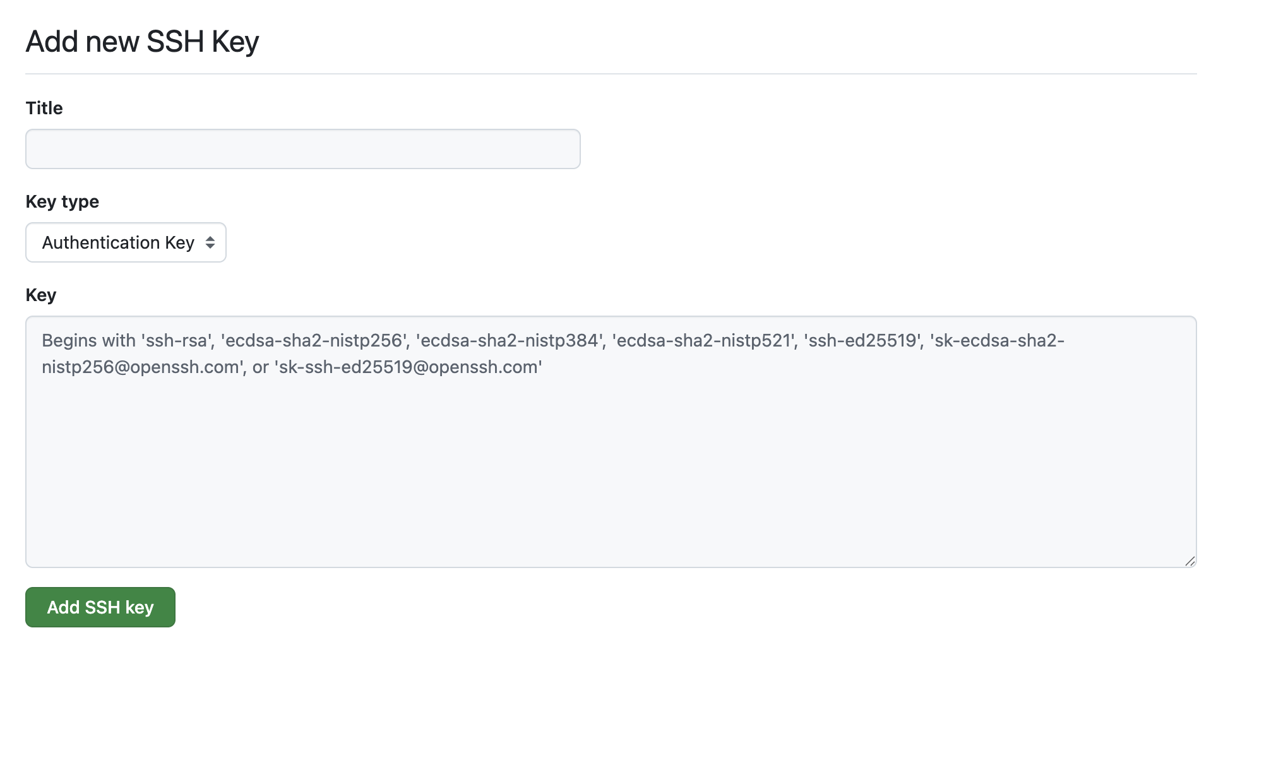

Slide 10
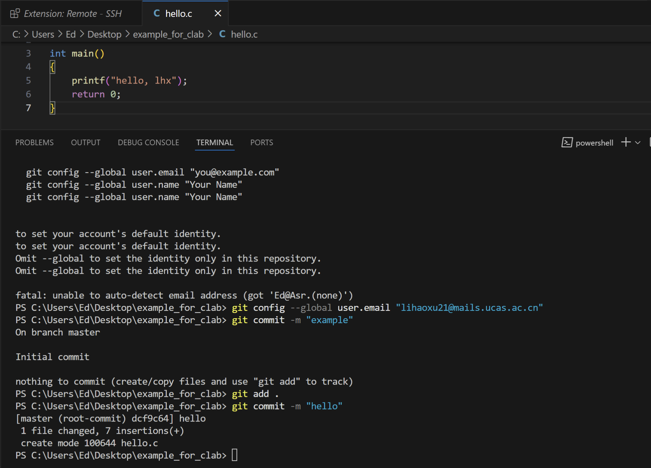

Slide 11
git init
git config --global user.email “lihaoxu21@mails.ucas.ac.cn”
git add .
git commit -m “hello”
git remote add origin git@github.com:LiHaoxu/example_clab.git
git push -u origin main

Slide 12
